Slide 1


SIMARAN GUPTA National Institute of Technology, Kurukshetra B.Tech (COMPUTER ENGINEERING)
Kirana Club: ML/DS Internship Assignment

Slide 2
CONTENTS OF THE PRESENTATION:
Introduction
Objective
Assignment Problem
Solution Section 1: EDA
Explanation Section 1
Solution Section 2: Coding
Explanation Section 2

Slide 3
Introduction:
Objective:
1
You are given a dataset that contains all the transactions occurring for a store.
On this dataset do an extensive EDA and explain your findings using relevant visualizations
2
Answer the questions contained in the attached notebook in the most optimum way.
Section2-Notebook.ipynb
.

Slide 4
Assignment Problem:
Section 1: EDA
You are given a dataset that contains all the transactions occurring for a store. On this dataset do an extensive EDA and explain your findings using relevant visualizations. Some of the questions you can answer in the EDA:
Can customers be segmented into different categories? If yes then perform analysis on the same and also propose categories. If no, then explain why?
How would you define a loyal customer?
What is the most popular time of year based on this sales data?
Is there any seasonality in data? Explain with supportive evidence.
Discuss customer's lifetime with respect to the given dataset.
Dataset: RetailPulseAssignmentData.xlsx

Slide 5
Assignment Problem:
Section 2: Coding
Answer the questions contained in the attached notebook in the most optimum way.
Section2-Notebook.ipynb
Data:
section2_data.txt

Slide 6
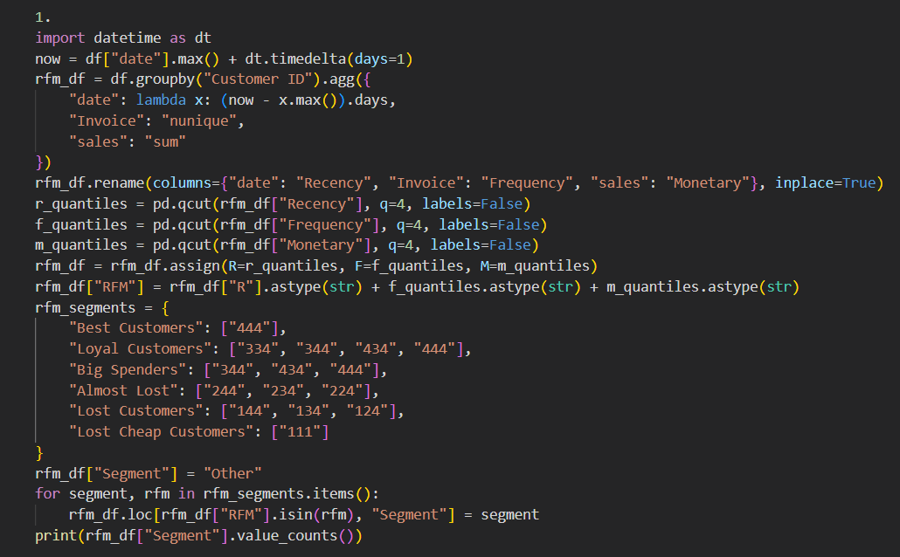
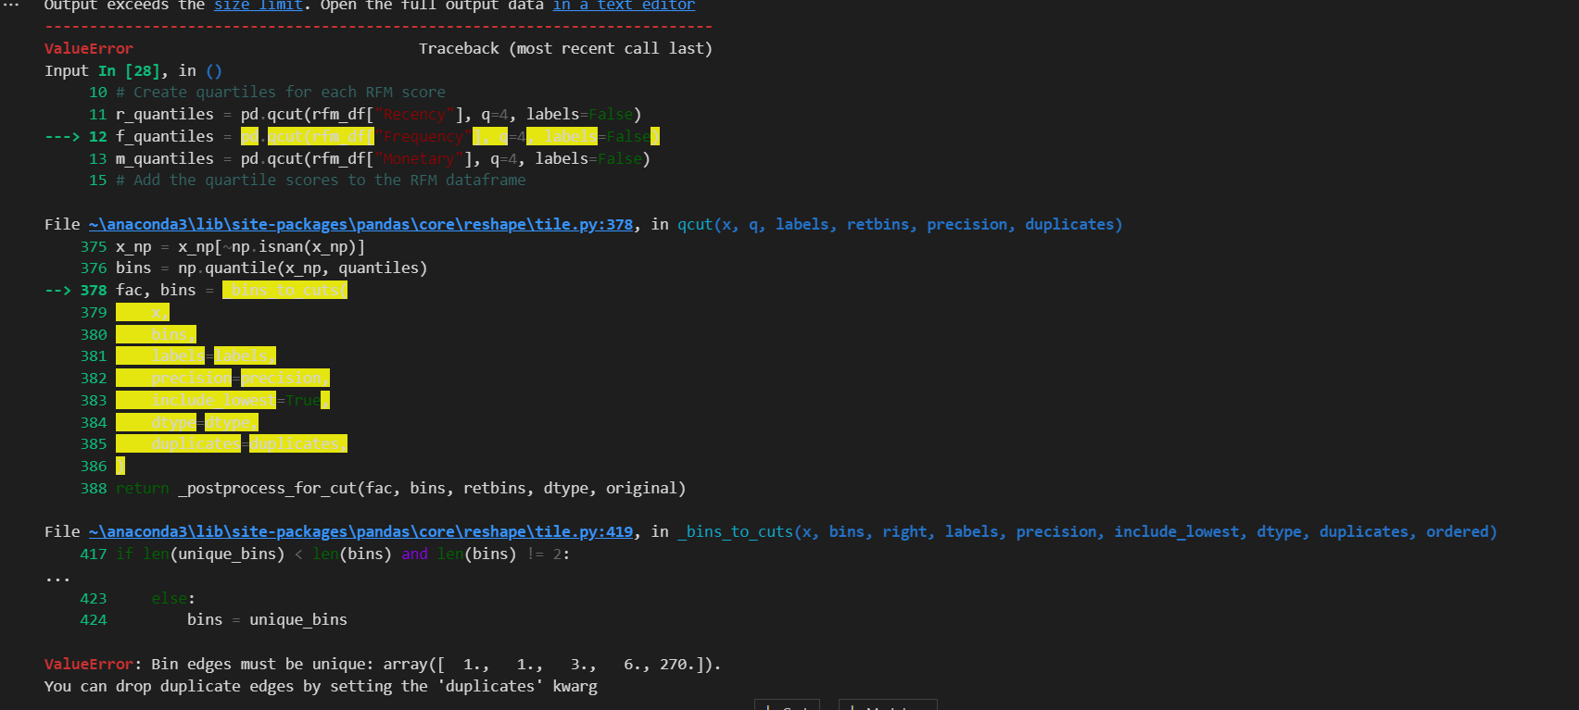
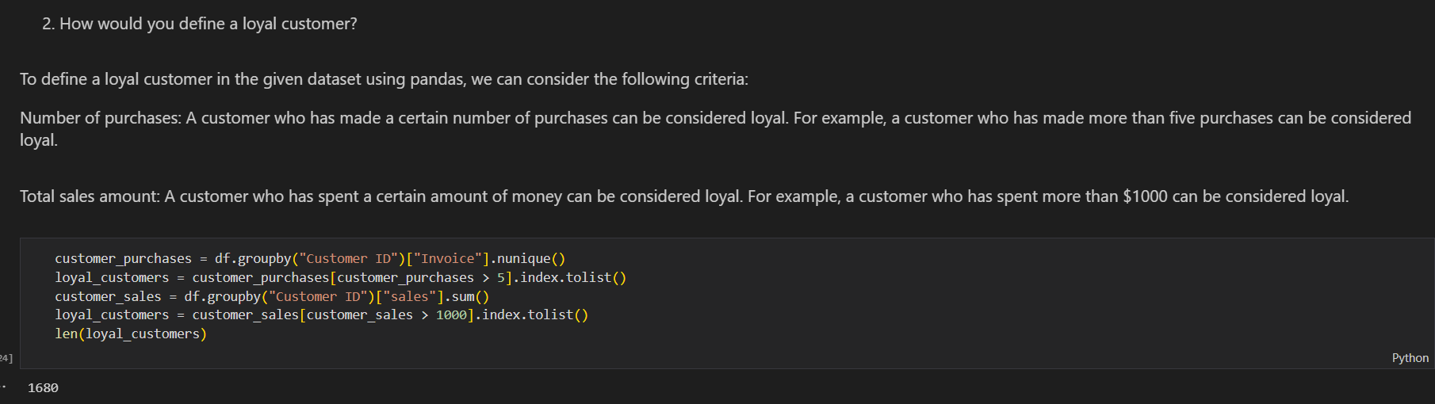
Solution Section 1: EDA Explanation Section 1

Slide 7
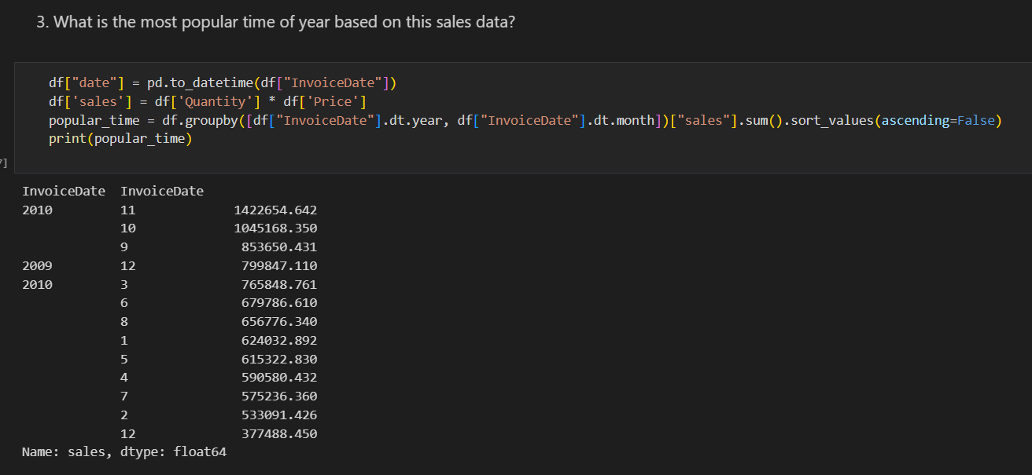
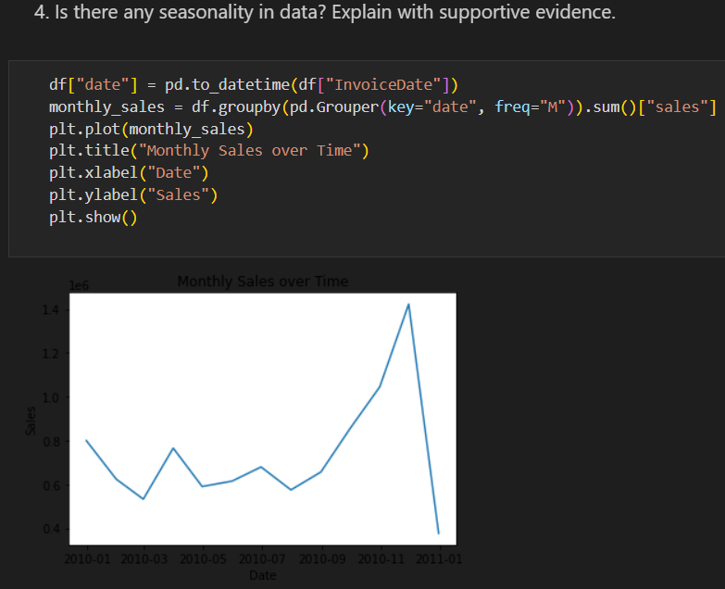
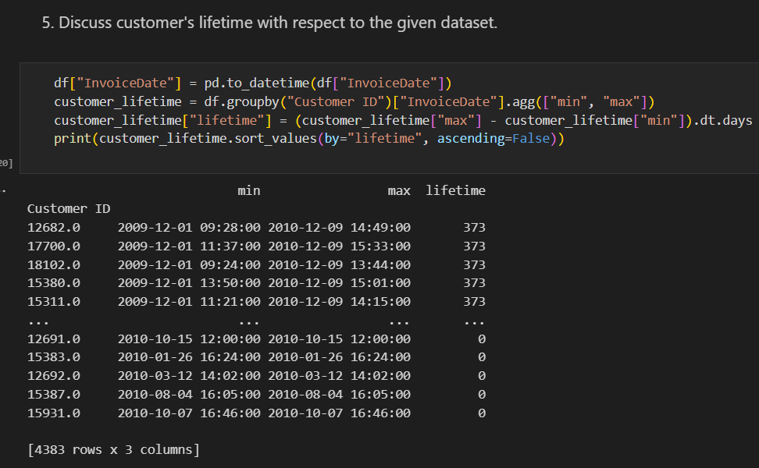
Solution Section 1: EDA Explanation Section 1

Slide 8
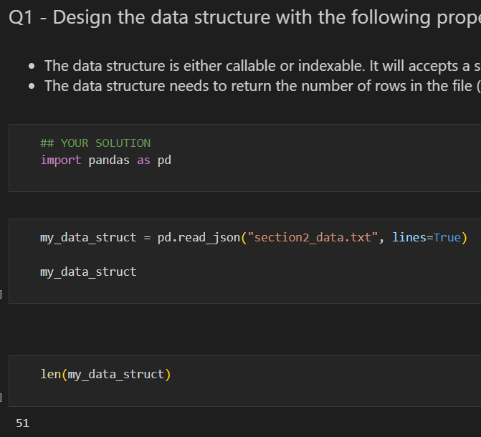
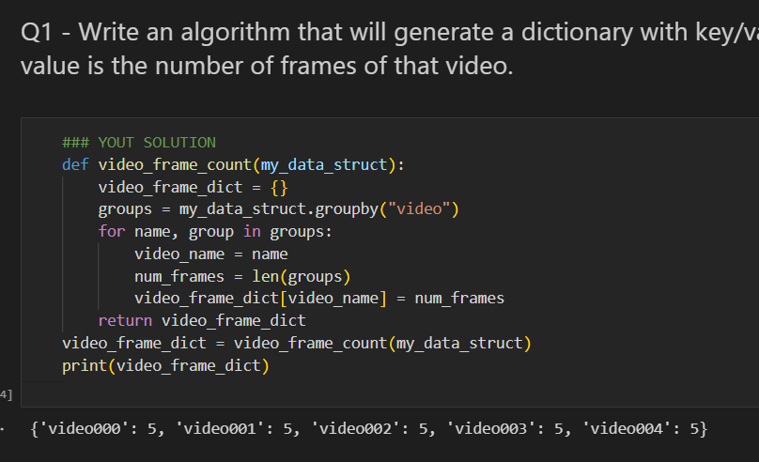
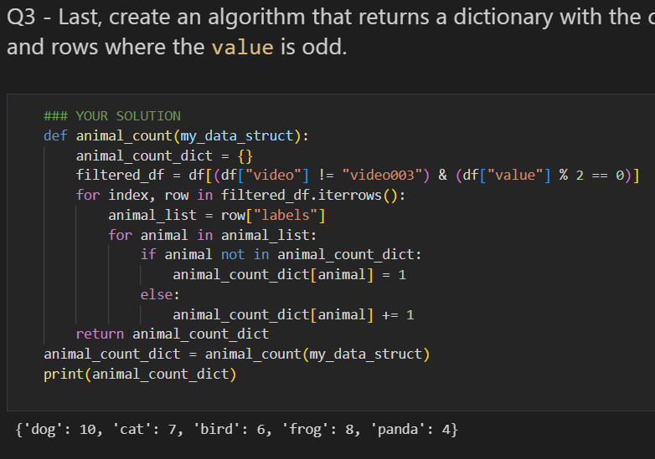
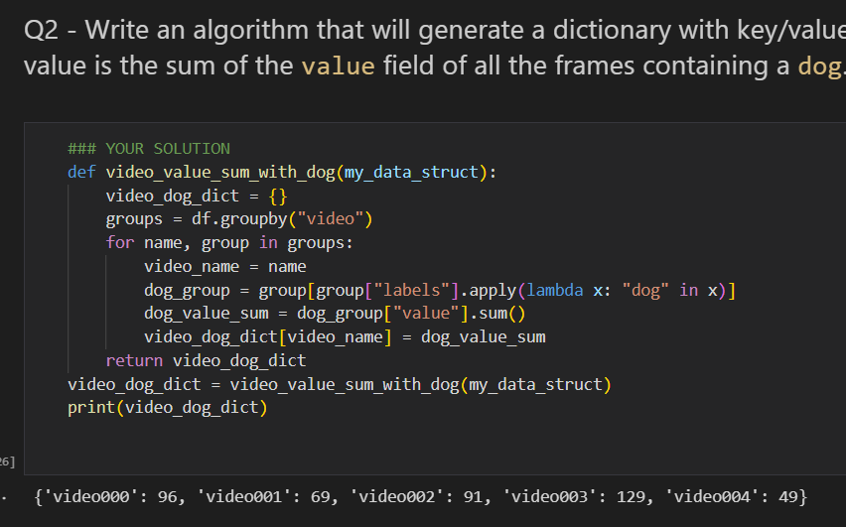
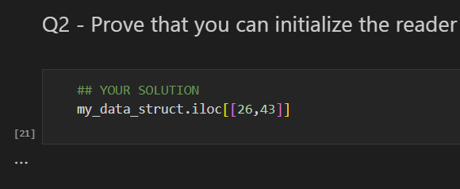
Solution Section 2: Coding Explanation Section 1
Section 1: Design a data loader: Section 2: Process of data:

Slide 9
THANKS YOU

